Slide 1

Le Roy-Ostrander
Public School
Facilities Task Force Recommendations

Slide 2
Overview
Problem Statement:
Lack of effective and efficient educational space, compounded by the lack of a plan for current and future needs.
Goal Statement:
To create a comprehensive facility plan, supported by community stakeholders, which provide an effective learning environment for current and future needs.

Slide 3
Overview
What was needed to gain community support?
  Communities perspective
    Plan for growth
    Related tax impact
  Collaboration and Communication
Why was the Facilities Task Force started?
  2016 bond referendum
  2016 levy

Slide 4
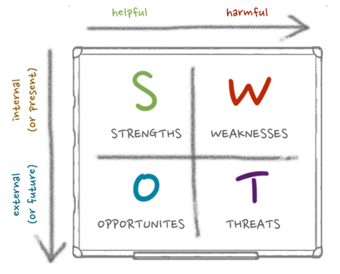
Facilities Task Force
Open Community Forum
  Determinations
    SWOT Analysis
    15-20 year plan
Meetings
  15 Facilities Task Force meetings over 5 months
  Facilitator – Gary Kuphal
  Community volunteers – 25 members

Slide 5
Resources
The Facilities Task Force met or spoke with the following companies/people:
Braun Intertec
Custom Alarm
Dunham Associates
Eagle Ridge Tactical Consulting, L.L.C.
G. A. Ernst & Associates, Inc.
Le Roy Lumber Yard
MEP Associates
Predictive Technologies, Inc.
Rochester Public Utilities
Southern Minnesota Initiative Foundation (SMIF)
UNESCO
Winona Heating and Ventilating
Tim Bly
Aaron Hungerholt
Deb Reburn

Slide 6
Facilities Task Force Members
Facilitator: Gary Kuphal
Teresa Frazer
Jennifer Gumbel
Kevin Janssen
Brad Johnson
Dave Kasel
Steve Kasel
Angie Kennedy
Justin Kennedy
Lynda Koch
Damon Lazzara
Tim Lewison
Dan Lohuis
Dan Lowe
Dave Lunning
Gene Miller
Richard Nagele
Carolyn Nagele
Kate Rohrer
Jill Soltau
Leonard Soltau
Tom Soltau
DJ Start
Britt Wehrenberg
Wendy Vikre
Mike Welsh

Slide 7

HVAC System
Indoor Air Quality
  Braun Intertec
Mechanical Equipment Assessment
  Predictive Technologies, Inc.
    Mechanical Reliability Study
    Mechanical Integrity – Steam Piping Thickness Testing
    Building Envelope Infrared Study
Energy Efficiency Evaluation
  G.A. Ernst & Associates, Inc.

Slide 8

HVAC Recommendations
Contract with a company like Predictive Technologies, Inc., Winona Heating and Ventilating to:
  Develop and create a maintenance and documentation plan
  Assist and train our custodial/maintenance staff with a daily/weekly/monthly maintenance schedule and proper documentation
  Monitor and help maintain the mechanical system
  Train our staff on the Building Automated Control System (BAS)
Recommission/calibrate the current system
Improve ventilation in the temporary elementary classrooms by adding exhaust vents/fans, fresh air intake, and dual zone temperature control and correct any mold issues that may exist

Slide 9
HVAC Recommendations
Reclaim/Recommission vents and exhaust fans that have been covered up with the steel roof to bring the building back to "design" to balance stale air exhaust with fresh air ventilation, starting with elementary, high school, common areas, and then other remaining areas
Get all areas of the building connected to the BAS for energy efficiency and ease of control
  Currently approximately 75% of the building is connected to the BAS
  Connect the remaining 25% to the BAS wirelessly or whatever is most cost effective for the area
Future consideration: As roof top units fail, consider replacing them with units that would include air conditioning.

Slide 10

Safety and Security
Security Assessments
  Custom Alarm
  Eagle Ridge Tactical Consulting, L.L.C.

Slide 11
Security Recommendations
Secure and remodel front entrance
  3rd set of secure doors placed past the trophy cases with buzzer system in administrative offices
  Waiting area created in secured area between 2nd and 3rd set of doors
    All parents/visitors to remain in waiting area after checking in at the office until child or staff member is able to meet them there
Secure all remaining entrances with alarms and cameras
Consider consulting companies like Custom Alarm,
Ban-Koe, Eagle Ridge Tactical Consulting, L.L.C., or other similar companies

Slide 12
Safety Recommendations
Consider switching faculty and student parking lots for additional student safety by not crossing County Road 14
Remove the housing structure on the West property
Add driveway around back of school for safe bus drop-off and additional parking
  Create an additional parking lot on the West property
  Driveway should be a one-way with buses entering from Highway 56 and exiting on County Road 14

Slide 13
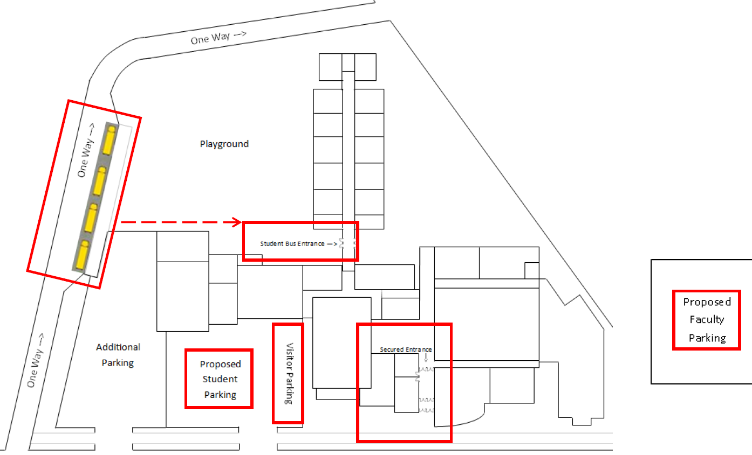
Example:

Slide 14

School Readiness Programs and Educational Classrooms/Space
School Readiness Programs
  Deb Reburn, School Readiness Coordinator/Teacher
Educational Classrooms/Space
  Aaron Hungerholt, School Principal

Slide 15
School Readiness Programs and Educational Classrooms/
Space Recommendations
Develop a plan to replace existing temporary two classroom structure on the North end of the elementary with a permanent structure of three to four classrooms within five years

Slide 16
Additional Considerations
Energy Efficiency Evaluation
  G.A. Ernst & Associates, Inc.
School Operated Daycare
  Southern Minnesota Initiative Foundation (SMIF)
Pool
Tour Observations

Slide 17
Additional
Recommendations
Energy/cost savings:
  Lighting – LED bulb replacement plan as bulbs burn out
  Submit for tax exemption status through Minnesota Energy Resources
  Submit for refund of sales tax up to 3 years retroactive from MN Dept of Revenue
  Submit for additional rebates per G. A. Ernst & Associates, Inc. report through Minnesota Energy Resources and Freeborn Mower Cooperative Services, if applicable

Slide 18

Additional
Recommendations
Continuous improvement of building and grounds appearance:
  Tuck pointing of exterior
  Create an appearance improvement plan
    Create a rotating appearance improvement plan
      Tile/paint/flooring/fixtures
    Exterior - annually
      Mold removal off brick – pressure washing
      Landscaping – manicured and trimmed
    Interior - annually
      Deep cleaning of all areas
  Restrooms
    Visitor restrooms on main level off commons – remodel/update
    Continued maintenance/replace fixtures on all restrooms as needed

Slide 19
Items not supported by the Facilities Task Force Group
School operated daycare facility (Ages 0-3)
No additional square footage added for new administrative offices
Full replacement of the HVAC system

Slide 20
Summary
The process began with a community forum identifying the school district's Strengths, Weaknesses, Opportunities and Threats (SWOT) along with a 15-20 year viability plan. The Facilities Task Force utilized the information from the SWOT analysis, along with the additional information gathered during the process, to help develop their recommendations relating to facilities and suggests that the school board utilize this information to develop a long range strategic plan.
While the Facilities Task Force does not have actual costs, we have reason to believe that these recommendations would cost considerably less than that of the proposed levy and bond referendum voted on in November 2016.
While some of the Facilities Task Force recommendations may require a bond referendum, the timing and scope of the referendum will be left up to the school board.
The Facilities Task Force would like to thank the school board for the opportunity to have community involvement and allowing us the time, space, and funds to complete a thorough due diligence on behalf of the community for the future of the school.

Slide 21
Questions

